Slide 1


North American Airports & Complex Network
Course Project of Complex Network.
Professors:
Dr. Chen
DR. Hu
Students:
Keyvan derakhshan nik
Huizhong liu

Slide 2

Importance of Airport Network
700 million passenger traveled through 20 busiest airport around the world. (https://www.virgin.com)
North America’s commercial airports are generating billions of dollars in annual activity, and supporting millions of good, stable jobs. (http://aci-na.org)

Slide 3
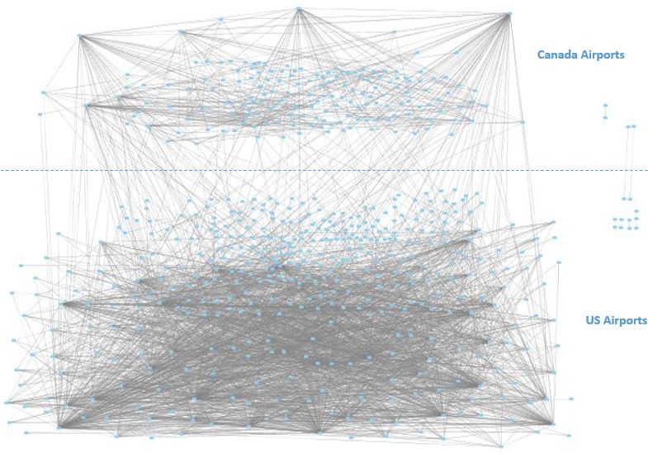
North America Airport Connected Graph
Number of nodes: 592
Number of links: 3052
Number of components: 8
Density: 0.017446380390542828
Ave clustering coefficient : 0.48204334679682737
Ave degree : 10.31081

Slide 4
Connected Airport Graph

Slide 5
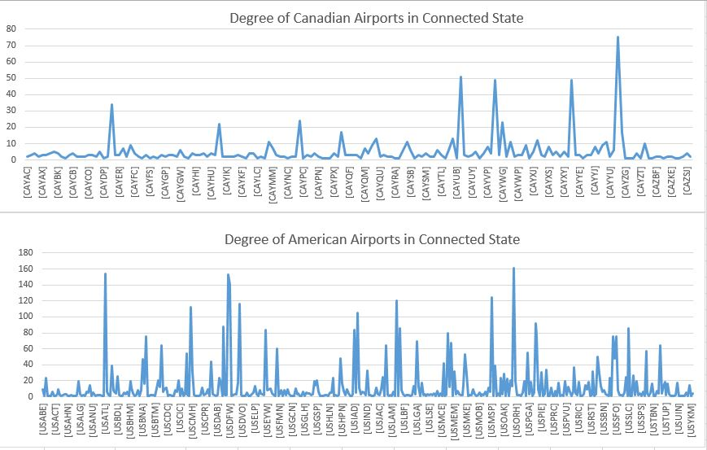
Degrees Distribution For Connected Graph
Rank | Airport | Degree
1 | USORD(Chicago) | 161
2 | USATL(Atlanta) | 154
…
19 | CAYYZ(Toronto) | 75
20 | USBOS(Boston) | 75
21 | USSEA(Seattle) | 75
22 | USSFO(SanFrancisco ) | 75
120 | CAYYT(St. John’s) | 11

Slide 6
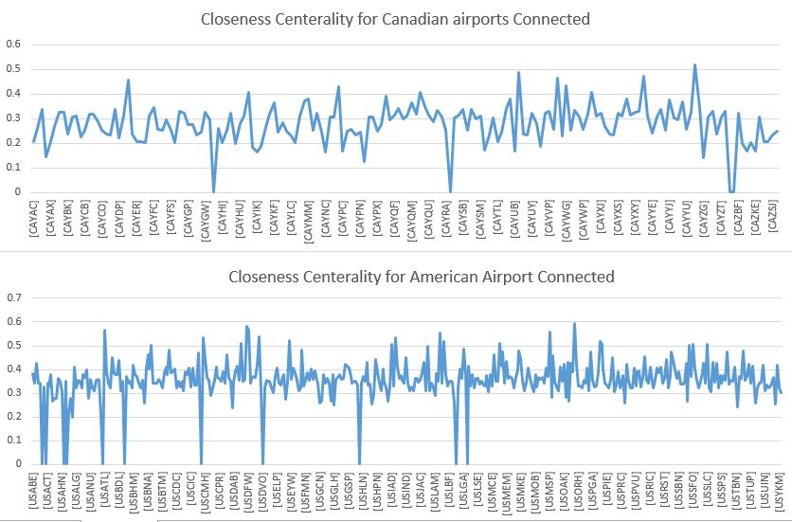
Closeness Centrality For Connected Graph
Rank | Airport | Closeness
1 | USORD(Chicago) | 0.592007
2 | USDEN(Denver) | 0.582588
…
13 | CAYYZ(Toronto) | 0.517738
174 | CAYYT(St.john’s) | 0.367867

Slide 7
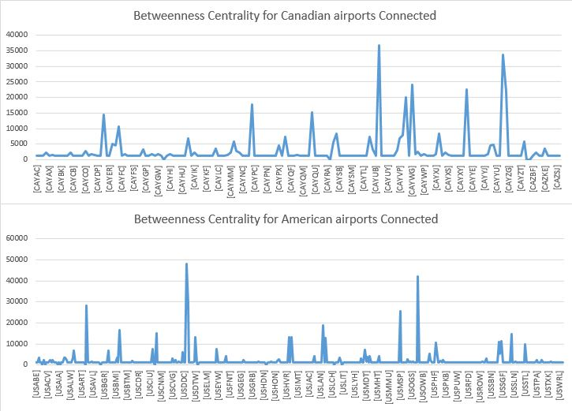
Betweenness Centrality For Connected Graph
Rank | Airport | Betweenness
1 | USDEN(Denver) | 48177.33425
2 | USORD(Chicago) | 42043.0673
3 | CAYUL(Montréal) | 36660.05137
48 | CAYYT(St.john’s) | 4738.30508

Slide 8
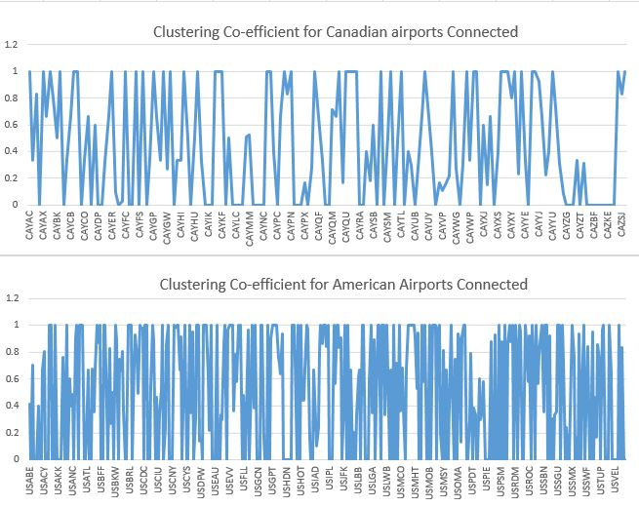
Clustering Co-efficient For Connected Graph
Number of Clustering Co-efficient =1 in Canada | 45
Number of Clustering Co-efficient =0 in Canada | 56
Number of Clustering Co-efficient =1 in US | 107
Number of Clustering Co-efficient =0 in Canada | 146

Slide 9
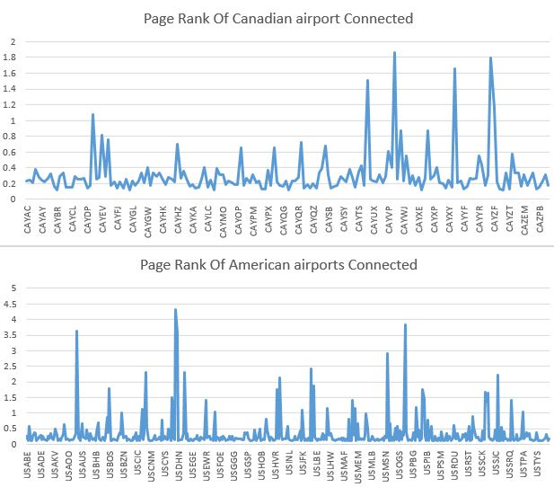
Page Ranks For Connected Graph
Rank | Airport | Page Rank
1 | USDEN(Denver) | 4.331499207
2 | USORD(Chicago) | 3.84651018
…
12 | CAYVR(Vancouver) | 1.866574987
13 | CAYYZ(Toronto) | 1.793256233
48 | CAYYT(St.john’s) | 0.442243

Slide 10
Disconnected Airport Graph

Slide 11
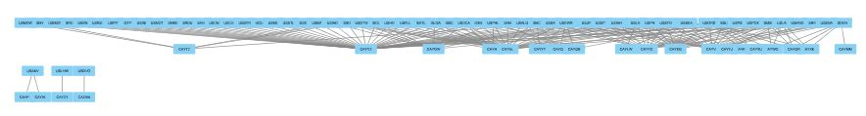
Border Edges Between US and Canada Which Assumed Are Removed
Rows | Airports | Number of deleted edges
1 | CAYYZ(Toronto) | 46
2 | CAYUL(Montréal) | 25
3 | CAYVR(Vancouver) | 18
4 | CAYYC(Calgary) | 17
5 | USORD(Chicago) | 13
…
 | CAYYT(St.john’s) | 2
Number of nodes: 81
Number of links: 170
Number of affected Components: 4

Slide 12
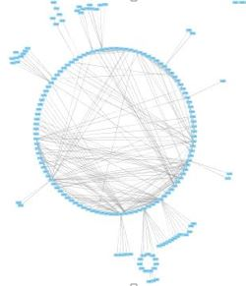
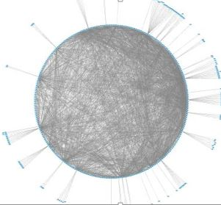
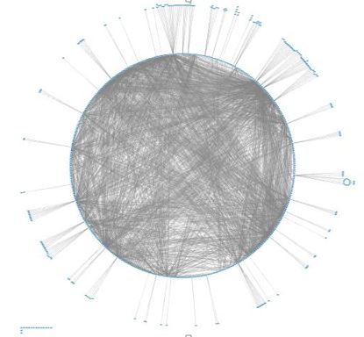
US and Canada Airport’s Disconnected Networks
Just Canada
Number of nodes: 172
Number of links: 370
Number of components: 3
Density:0.025159798721610227
Ave clustering coefficient : 0.43987601150772704
Ave degree : 4.30232558139534
Just US
Number of nodes: 414
Number of links: 2512
Number of components: 5
Density: 0.02938320992853049
Ave clustering coefficient : 0.49931501299812453
Ave degree : 12.1352657
All Connected
Number of nodes: 592
Number of links: 3052
Number of components: 8
Density: 0.017446380390542828
Ave clustering coefficient : 0.48204334679682737
Ave degree : 10.31081

Slide 13
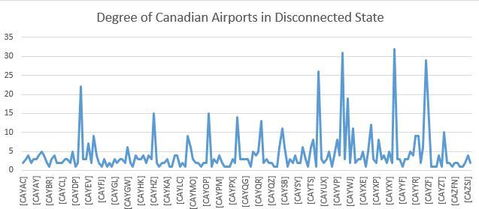
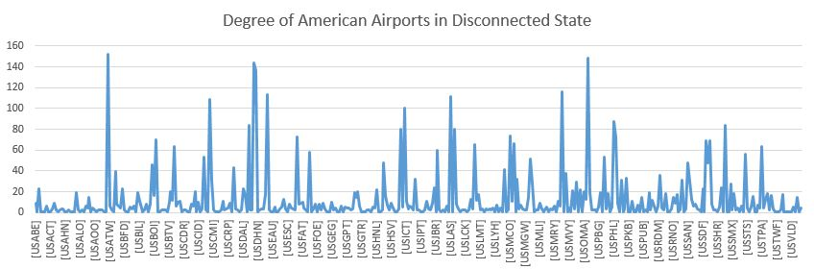
Degrees Distribution For Disconnected Graph
Rank | Airport | Degree
 | USATL(Atlanta) | 152
 | USORD(Chicago) | 148
…
 | CAYYC(Calgary) | 32
 | CAYVR(Vancouver) | 31
 | CAYYT(St.john’s) | 9

Slide 14
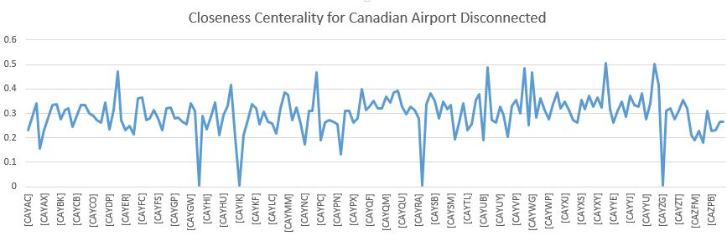
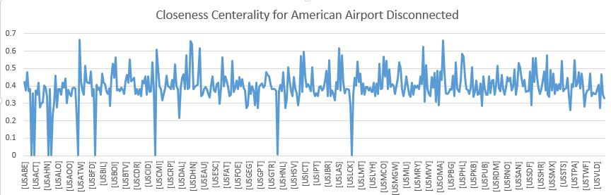
Closeness Centrality For Disconnected Graph
Rank | Airport | Closeness
 | USATL(Atlanta) | 0.663640032
 | USORD(Chicago) | 0.661016949
 | USDEN(Denver) | 0.656981437
…
 | CAYYC(Calgary) | 0.50561125
 | CAYYZ(Toronto) | 0.50214425
 | CAYYT(St.john’s) | 0.384

Slide 15
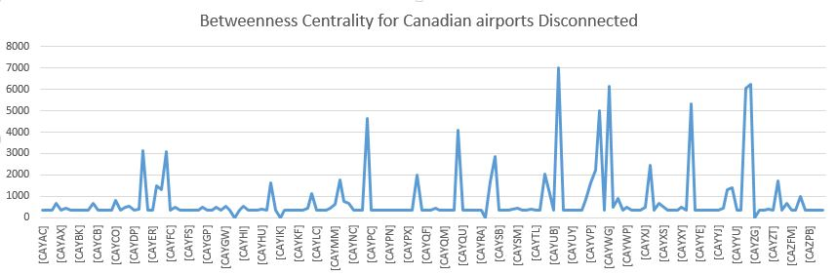
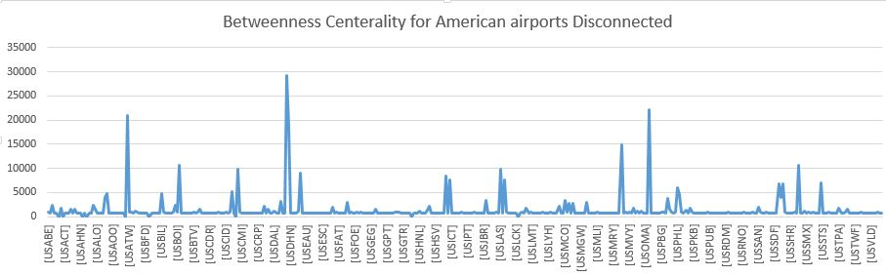
Betweenness Centrality For Disconnected Graph
Rank | Airport | Betweenness
 | USDEN(Denver) | 29262.87307
 | USORD(Chicago) | 22112.2596
…
 | CAYUL(Montréal) | 7022.245061
 | CAYYT(St.john’s) | 1417.4412

Slide 16
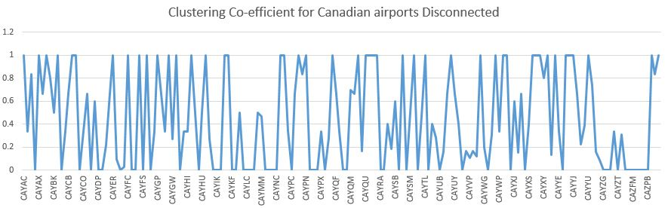
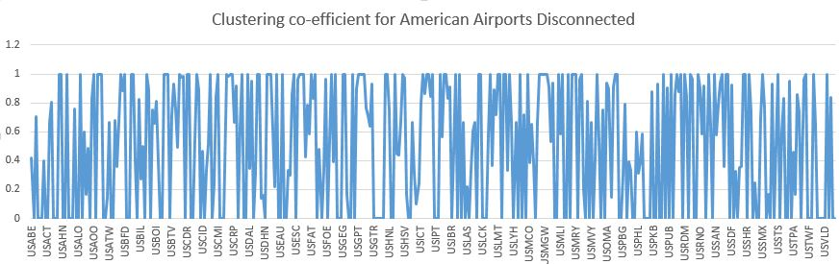
Clustering Co-efficient For Disconnected Graph
Number of Clustering Co-efficient =1 in Canada | 45
Number of Clustering Co-efficient =0 in Canada | 55
Number of Clustering Co-efficient =1 in US | 106
Number of Clustering Co-efficient =0 in Canada | 144

Slide 17
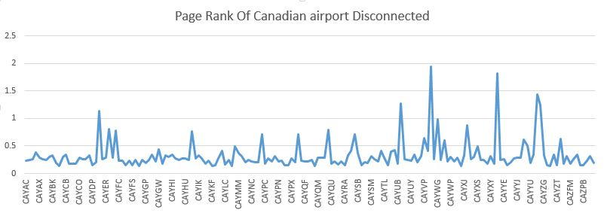
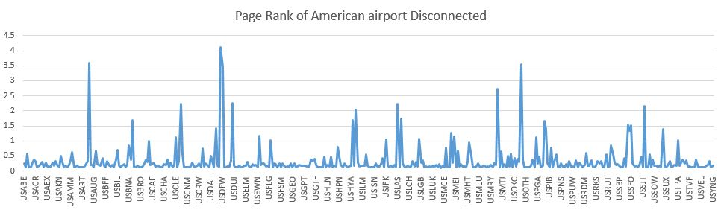
Page Ranks For Connected Graph
Rank | Airport | Page Rank
 | USDEN(Denver) | 4.121449052
 | USATL(Atlanta) | 3.597149773
 | USORD(Chicago) | 3.535110628
..
 | CAYVR(Vancouver) | 1.948732356
 | CAYYC(Calgary) | 1.827781985
 | CAYYT(St.john’s) | 0.50698

Slide 18
Comparison

Slide 19
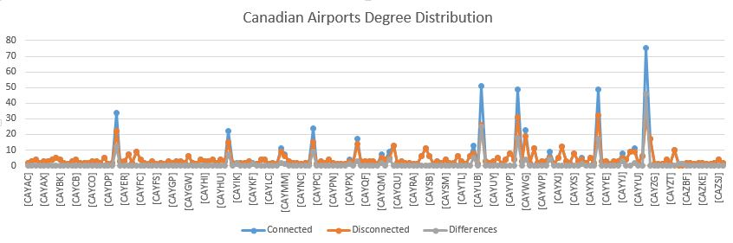
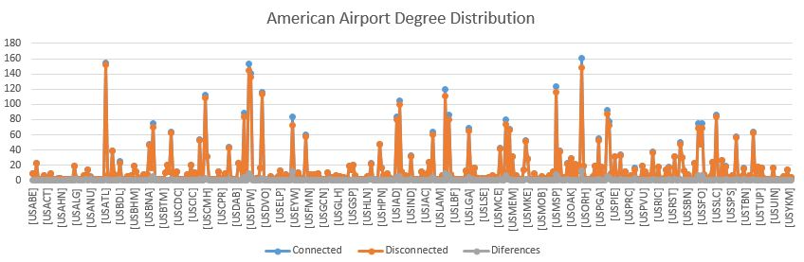
Comparison Degree Distribution
Airport code | City name | Difference Percentage
CAYYZ | Toronto | -61.33%
CAYUL | Montréal | -49.02%
CAYVR | Vancouver | -36.73%
CAYYC | Calgary | -34.69%
USORD | Chicago | -8.07%

Slide 20
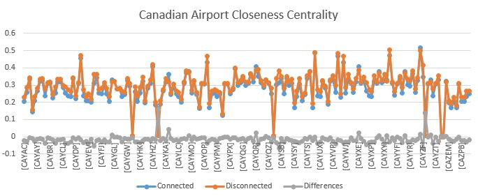
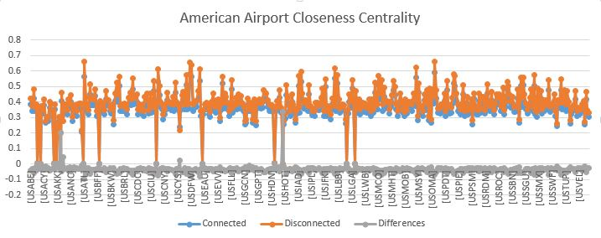
Comparison Closeness Centrality
Airport code | City name | Difference Percentage
CAYIK | Ivujivik, QC | -96.46%
CAYZG | Salluit, QC | -95.85%
CAYKF | Breslau, ON | -11.99%
USALG |  | -13.31%

Slide 21
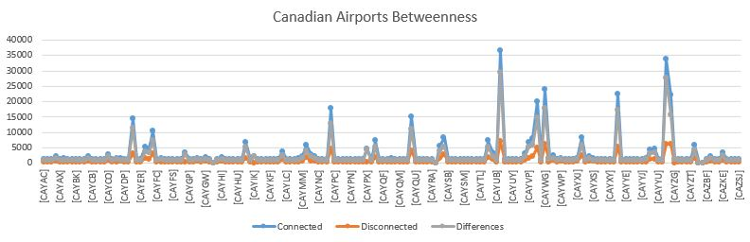
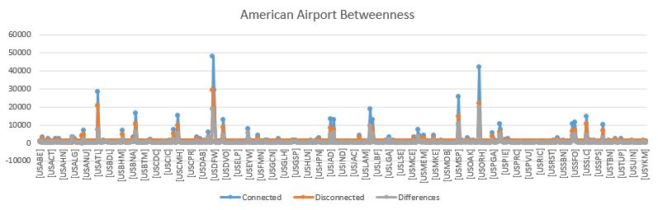
Comparison Betweenness Centrality
Airport | City | Difference Percentage
CAYUL | Montréal | -80.84%
CAYYZ | Toronto | -82%
USORD | Chicago | -47.40%

Slide 22
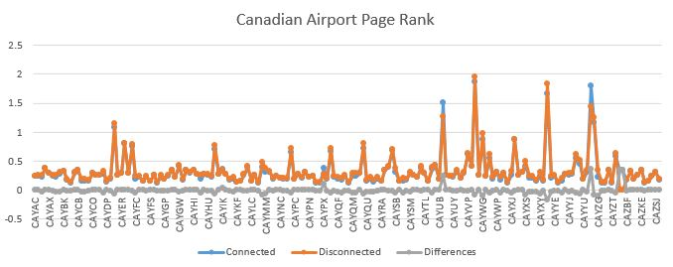
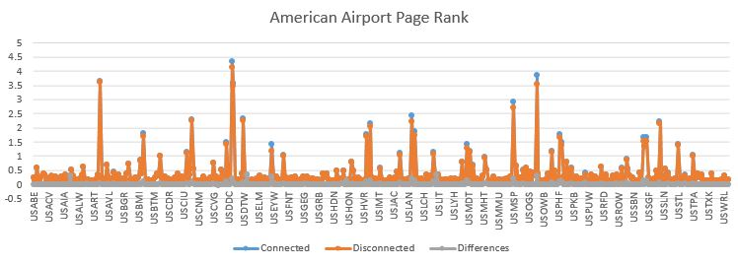
Comparison Page Rank
Airport code | City name | Difference Percentage
CAYYZ | Toronto | -19.56%
USORD | Chicago | -8.09%
USEWR | Newark, NJ | -17.78%
CAYUL | Montréal | -15.72%

Slide 23
Conclusion

Slide 24
Conclusion
Based on Closeness and Between Centrality, Degree and Page Rank:
The most important Canadian airports : YYZ(Toronto), YVR(Vancouver) , YYC(Calgary), YUL(Montréal), YEG(Edmonton).
The most important US airports : ATL(Atlanta),ORD(Chicago), DEN(Denver), DFW(Dallas), MSP(Minnesota).
US airline system is much more robust than CA airline system, based on the average clustering coefficient and density.
If the connection between US and CA disconnected:
Canadian Airports will loose more edges (Degree Comparison).
Closeness Centrality in Canadian Airports effected strongly.
Betweenness Centrality in Canadian Airports effected strongly.
The Page Rank of Airports are not affected hardly.
4 US airports and 2 CA airports could died at all. Such as USAKV, USHOG, USDVO, USLHW,CAYZY, CAZAM.

Slide 25

Thank You

